Slide 1
Objectives
  In this lesson, you will learn about:
    Identify features of message-driven beans
    Explain the life cycle of message-driven beans
    Identify steps to create message-driven beans
    Create applications using message-driven bean
    Secure EJB applications

Slide 2
Pre-assessment Questions
  Which ACID property of a transaction ensures that data loss does not occur when a network or a system failure occurs?
    atomicity
    consistency
    isolation
    durability

Slide 3
Pre-assessment Questions (Contd.)
  Which ACID property allows multiple transactions to read from or write to a database, one at a time?
    atomicity
    consistency
    isolation
    durability
  Which transaction attribute specifies that a bean method must always be part of an existing transaction?
    Mandatory
    Required
    RequiresNew
    Supports

Slide 4
Pre-assessment Questions (Contd.)
  What is the responsibility of the bean provider?
    Rolls back the transaction.
    Generates an application error.
    Throws the exceptions, java.rmi.RemoteException or javax.ejb.EJBException, depending on whether the client is remote or local, respectively.
    Enables a JTA transaction to invoke a method in a stateful session bean even if the method has closed the connection to the database.

Slide 5
Pre-assessment Questions
  Which constant declared in the javax.transaction.Status interface specifies that the current transaction is preparing for transaction commit?
    STATUS_PREPARING
    STATUS_ACTIVE
    STATUS_COMMITTING
    STATUS_PREPARED

Slide 6
Solutions to Pre-assessment Questions
  d. durability
  c. isolation
  a. Mandatory
  d. Enables a JTA transaction to invoke a method in a stateful session bean even if the method has closed the connection to the database.
  a. STATUS_PREPARING

Slide 7
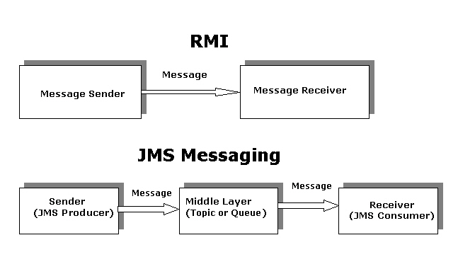
Introducing Message-Driven Beans
  Provide asynchronous messaging between two Java components.
  Uses Java Message Service (JMS) Application Programming Interface (API) to receive messages from the components.
  Introducing JMS
    JMS API allows Java programs to send and receive messages.
    Difference between JMS and RMI

Slide 8
Introducing Message-Driven Beans (Contd.)
    Advantages of JMS API are:
      Better performance
      Reliability
      Multiple Messaging
    JMS API supports two types of messaging techniques:
      Publish/Subscribe (Pub/Sub)
      Point-to-Point (PTP)

Slide 9
Introducing Message-Driven Beans (Contd.)
  Features of Message-Driven Beans
    They are stateless because they do not store the state of the client.
    Instances are stored in a shared pool and EJB container can use any instance from this pool to receive and process the incoming message.
    They cannot return values or throw exceptions to the client.
    They can be declared as durable or non durable JMS consumers.

Slide 10
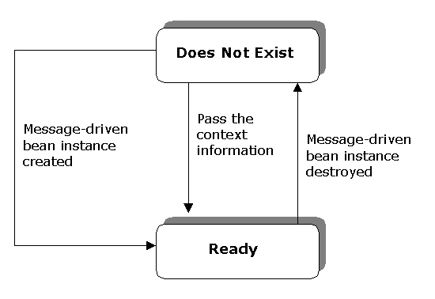
Introducing Message-Driven Beans (Contd.)
  Life Cycle of Message-Driven Beans

Slide 11
Introducing Message-Driven Beans (Contd.)
    Ready Stage
      Message-driven bean instance remains in the pool to service the messages sent by the clients .
      To add a new message-driven bean instance to the pool, EJB container performs the following steps:
        Call the setMessageDrivenContext() method to pass the context object to a message-driven bean instance.
        Call the ejbCreate() method of the instance to initialize the message-driven bean.

Slide 12
Introducing Message-Driven Beans (Contd.)
    Does Not Exist Stage
      Message-driven bean is permanently removed from the message-driven bean pool.
      The onMessage() method is called whenever a message is received from the client.

Slide 13
Introducing Message-Driven Beans (Contd.)
  Methods in a Message-Driven Bean
    setMessageDrivenContext(MessageDrivenContext)
    ejbCreate()
    onMessage(Message)
    ejbRemove()

Slide 14
Introducing Message-Driven Beans (Contd.)
  The setMessageDrivenContext(MessageDrivenContext) Method
  Receives a MessageDrivenContext object
    setRollbackOnly(): Declares that the current transaction should be rolled back.
    getRollbackOnly(): Checks whether the current transaction is declared for rollback or not.
    getUserTransaction(): Returns the javax.transaction.UserTransaction interface that enables you to retrieve information about a transaction and manage it.

Slide 15
Introducing Message-Driven Beans (Contd.)
    The ejbCreate() Method
      Creates a new message-driven bean.
      You can also pass arguments in the ejbCreate() method to initialize a message-driven bean instance.
    The ejbRemove() Method
      Destroys a message-driven bean and releases all the resources associated with it.
      Throws the exception, EJBException, to handle errors that occur during the removal of a message-driven bean.

Slide 16
Introducing Message-Driven Beans (Contd.)
    The onMessage(Message) Method
      Implements the business logic in a message-driven bean.
      Accepts the incoming message as an argument of the Message class type.

Slide 17
Introducing Message-Driven Beans (Contd.)
  Deployment descriptor of Message-Driven Bean
    Various tags in a message-driven bean are:
      <ejb-name>
      <ejb-class>
      <message-driven>
      <transaction-type>
      <message-driven-destination>
      <destination-type>

Slide 18
Introducing Message-Driven Beans (Contd.)
  Responsibilities of the Bean Provider and the EJB Container Provider
    The code of a message-driven bean class should fulfill the following criteria:
      Should implement the javax.ejb.MessageDrivenBean and javax.jms.MessageListener interfaces.
      Should be defined as a public class. However, it cannot be defined as the final or abstract class.
      Should contain one constructor that takes no arguments.
      Should implement the ejbCreate(), ejbRemove(), and onMessage() methods.

Slide 19
Introducing Message-Driven Beans (Contd.)
  Responsibilities of the Bean Provider and the EJB Container Provider
    The code of a message-driven bean class should fulfill the following criteria:
      Should implement the javax.ejb.MessageDrivenBean and javax.jms.MessageListener interfaces.
      Should be defined as a public class. However, it cannot be defined as the final or abstract class.
      Should contain one constructor that takes no arguments.
      Should implement the ejbCreate(), ejbRemove(), and onMessage() methods.

Slide 20
Creating Message-Driven Beans
  Creating Java File to Implement a Message-driven Bean
    Contains the code to implement the business logic of a message-driven bean.
    The following code snippet shows the onMessage() method in the
    MessageListener interface:
    public interface javax.jms.MessageListener
    {
    public void onMessage(Message message);
    }

Slide 21
Creating Message-driven Beans (Contd.)
  Compiling and Deploying a Message-driven Bean
    Compiled using the javac compiler.
    Deployed in J2EE1.4 Application Server using the deploytool utility.
    The Enterprise Bean Wizard of the deploytool utility is used to deploy a message-driven bean.
  Accessing Message-driven Beans
    Application clients are stand-alone Java programs that can send JMS compatible messages to the message driven beans.
    Web-based clients are the Java components, such as JSP and servlets, which are run on a Web browser to access the message-driven beans.

Slide 22
Creating Message-driven Beans (Contd.)
  Handling Exceptions in a Message-Driven Bean
Condition for Exception
EJB Container’s Handling Action
Message-driven bean method is declared with the Required container-managed transaction attribute and a system exception occurs during the method execution.
EJB container saves the system exception into the log file and performs the rollback of the current transaction. EJB container also removes the current message-driven bean instance.

Slide 23
Creating Message-driven Beans (Contd.)
Condition for Exception
EJB Container’s Handling Action
Message-driven bean method is declared with the NotSupported container-managed transaction attribute and a system exception occurs during the method execution.
EJB container saves the exception into the log file and removes the current message-driven bean instance from EJB container.

Slide 24
Demonstration-Implementing Message-driven Beans
  Problem Statement
    Nancy is developing an application that will be used by a client to send JMS-compliant messages to the server. The application needs to store the received messages in a server log file. Nancy needs to use a message-driven bean for developing this application.

Slide 25
Demonstration-Implementing Message-driven Beans (Contd.)
  Solution
    To solve the problem, perform the following tasks:
      Create the message-driven bean class.
      Create the application client.
      Create the JMS connection factory resource.
      Create the JMS destination resource.
      Create the physical destination.
      Package the message-driven bean.
      Creating the application client JAR file.
      Configure the bean JAR file and client JAR module.
      Deploy the application.
      Test the application.

Slide 26
Securing EJB Applications
  Overview of EJB Security
    A J2EE server provides two methods to implement security, which are authorization and authentication.
    Authorization
      Refers to the process where the J2EE server controls the access to the methods in an enterprise bean .
        Declarative: Involves using EJB container to grant or deny the permission for accessing the methods.
        Programmatic: Involves explicitly writing the code for granting or denying permissions.

Slide 27
Securing EJB Applications (Contd.)
    Authentication
      Used to control access to the components in an application.
      The ways of classifying clients:
        Users
        Groups
        Realms
        Roles

Slide 28
Securing EJB Applications (Contd.)
  Specifying EJB Security Requirements in Deployment Descriptor
    The application assembler defines the security roles in the deployment descriptor to allow specific clients to access the resources.
    The code snippet to define a security role in the deployment descriptor is:
    <assembly-descriptor>
    <security-role>
    <description>
    This role includes the customers of a bank. The role allows the customers to view and update their information.
    </description>
    <role-name>Customer</role-name>
    </security-role>
    </assembly-descriptor>

Slide 29
Securing EJB Applications (Contd.)
  Accessing EJB Caller Security Context
    Bean provider uses the getCallerPrincipal() and the isCallerInRole() methods of the javax.ejb.EJBContext interface to retrieve information about a caller.
    The getCallerPrincipal() method returns an implementation of the java.security.Principal interface.
    The getName() method of the java.security.principal interface is used to retrieve the name of the caller.

Slide 30
Securing EJB Applications (Contd.)
  Responsibilities for Implementing Security
    Bean provider
    Application Assembler
    Deployer
    EJB container
    System administrator

Slide 31
Securing EJB Applications (Contd.)
    Responsibilities of the Bean Provider
      Use either programmatic or declarative method to specify the security attributes of an enterprise bean.
      Specify the names of the security roles in the <security-role-ref> tag of the deployment descriptor.

Slide 32
Securing EJB Applications (Contd.)
    Responsibilities of the Application Assembler
      Defining the security roles, which have the permission to access the resources in an enterprise bean application.
      Defining the method permissions for accessing the methods in the home and the component interface of an enterprise bean.
      Linking the security role names in the <security-role-ref> tag to the role names specified in the <security-role> tag of the deployment descriptor.
      Specifying the methods that need to be authorized prior to their invocation by the container.
      Specifying the methods that cannot be accessed by including them in the <exclude-list> tag in the deployment descriptor.

Slide 33
Securing EJB Applications (Contd.)
  Responsibilities of the Deployer
    Defining method permission for those methods that are neither present in the <exclude-list> tag nor associated with any security role.
    Matching the security attributes specified in the deployment descriptor to their corresponding security domains, where the application deploys.

Slide 34
Securing EJB Applications (Contd.)
    Responsibilities of EJB container
      Providing deployment tools to the deployer.
      Throwing the exceptions, java.rmi.RemoteException and javax.ejb.EJBException.
      Allowing the deployer to state whether the caller identity obtained from the getCallerPrincipal() method.
    Responsibilities of the System Administrator
      Creating a new user account.
      Adding a user account to a specific group.
      Removing a user account from a specific group.
      Deleting user account.
      Managing the security principals.

Slide 35
Practice-Implementing Message-driven Bean to Receive Messages
  Problem Statement
    The management of Blue Valley organization wants to implement messaging system in their organization. Robert, a software developer, is assigned the task of developing the messaging application. He needs to create a message-driven bean that receives JMS-compliant messages from a client application and stores them in the server log file.

Slide 36
Summary
  In this lesson, you learned:
    EJB 2.0 specification introduces a new type of bean known as message-driven beans. Message-driven beans are used for asynchronous messaging between two components of an EJB application.
    Message-driven beans act as the consumers of the messages that are sent by the clients capable of sending JMS-compatible messages.
    Message-driven beans contain a single business method, onMessage(), which is invoked on receiving a message.
    Message-driven bean contains the life cycle methods: ejbRemove(), ejbCreate(), and setMessageDrivenContext().
    The life cycle of a message-driven bean consists of two stages, Does Not Exist and Ready.

Slide 37
Summary (Contd.)
    The deployment descriptor of a message-driven bean is an XML file that specifies various features of the message-driven bean to the container.
    EJB security process involves allowing only authorized users to access the resources and applications.
    J2EE server provides two types of security, authentication and authorization.
    Application assembler defines the security roles that allow a client to access the resources. The application assembler uses the <security-role> tag to define the security roles and the methods associated with each security role, in the deployment descriptor.
    Bean provider uses the getCallerPrincipal() and isCallerInRole() methods to check whether the current client has the right to perform the operation or not.

